Slide 1
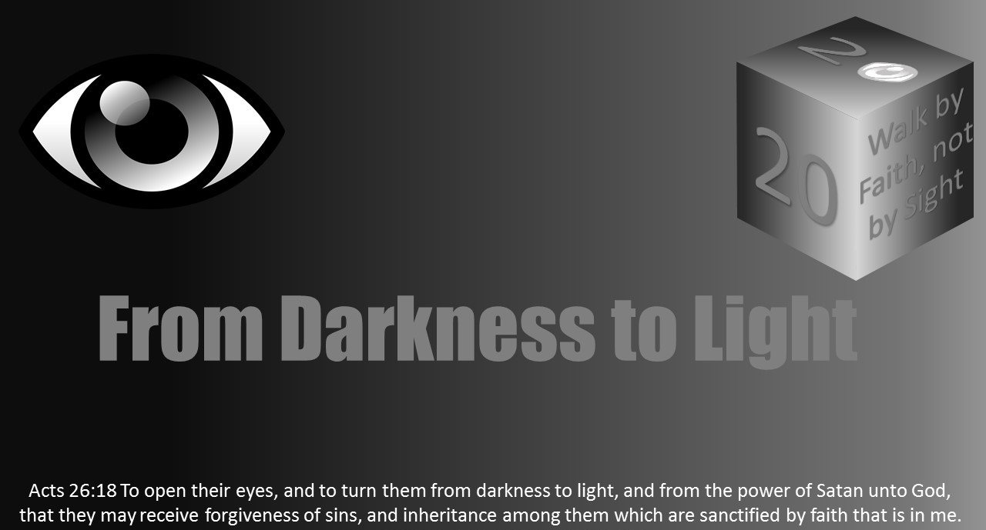


Slide 2
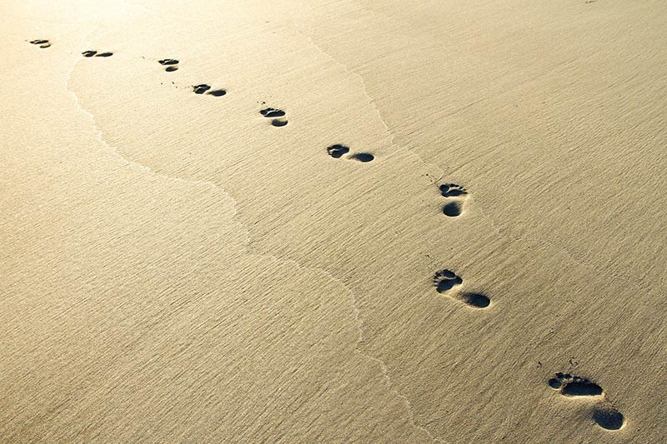
Light Lesson 16 Walking by Faith, Not by Sight

Slide 3
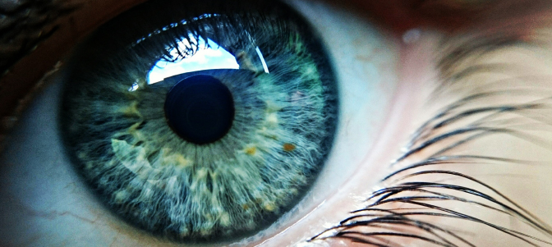
Introduction
The human eye remains a marvel.
The more we learn about how the eye and the brain function, the more impressed we are at its complexity and amazed that we can even see at all.
Through enhancements people can see stars and galaxies millions of light years away; they can also see down to the atomic level.

Slide 4

Introduction
We tend to take vision for granted and rely on it by default.
The old adage “seeing is believing” exists for a reason; we tend to trust what we see with our eyes and have difficulty imagining anything beyond what we can see.
By default, we tend to want to walk by sight: to see where we are going and to see what is ahead.
Few things terrify us more than the prospect of some lurking danger or hazard which we cannot see.

Slide 5
Introduction
Meanwhile, the more we can “see,” the more we learn just how limited our vision proves to be.
We have learned how other animals have a greater depth of visions than humans do.
We may be able to see all kinds of things thanks to enhancements like telescopes or microscopes, yet that knowledge only magnifies how little we are actually able to see just with our naked eye.
We are also learning how our brain sometimes plays tricks on us and “sees” things that are not really there or forms the image of things in ways that are not consistent with how they look in reality.
“Seeing is believing” leads to a warped sense of reality!

Slide 6
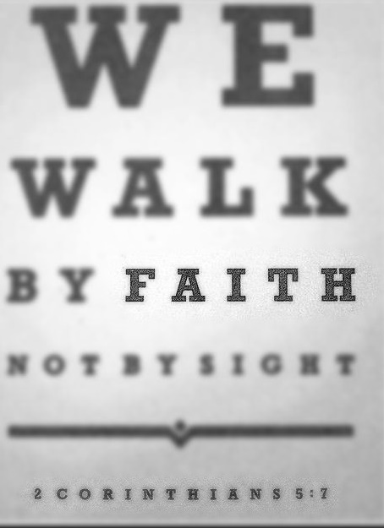
Faith and Sight
What is true about our physical sight is also true about our spiritual faith and knowledge.
The Apostle Paul declared that Christians walk by faith, not by sight, in 2 Corinthians 5:7.
He did so while encouraging the Christians in Corinth regarding their hope that Jesus would return one day to judge the world in righteousness and raise and transform the dead for immortality (2 Cor 4:7-5:10).

Slide 7
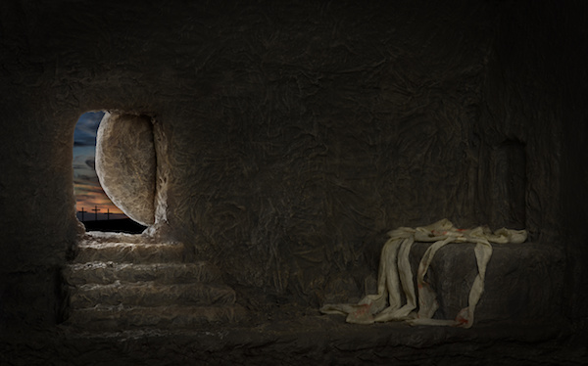
Faith and Sight
Throughout time mankind has known, for certain, that everyone dies, and the dead stay dead.
We know this because we have seen that everyone has died, and those who have died stay dead.
The disciples who followed Jesus knew this as well and were astonished when confronted with all the evidence that Jesus arose from the dead (Luke 24:36-43).

Slide 8
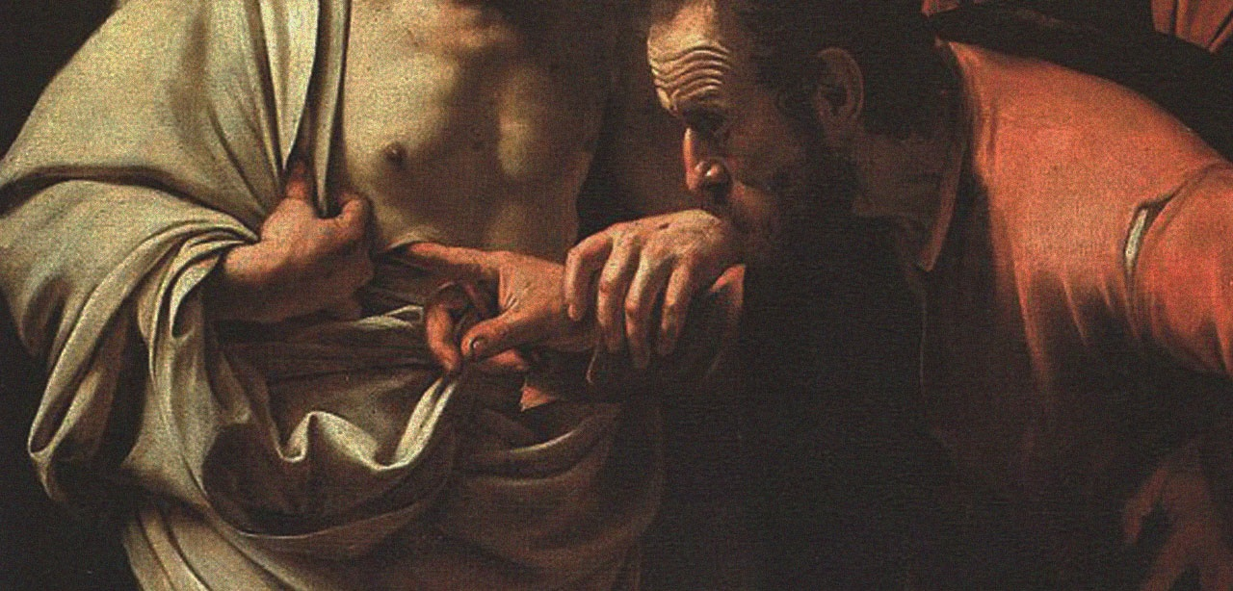
Faith and Sight
Upon hearing the claim of Jesus’ resurrection from fellow disciples, Thomas insisted he would not believe unless he had concrete, physical evidence.
Jesus appeared to him and gave him every reason to believe;
Thomas declared Jesus was his Lord and God (John 20:24-28).
Jesus asked Thomas if he believed because he saw, and then Jesus pronounced a powerful blessing: blessed are those who have not seen and yet have believed (John 20:29).

Slide 9
Faith and Sight
The resurrection of the dead therefore well demonstrates the difference between walking by faith and walking by sight.
It has been almost 2,000 years since anyone has seen the Lord Jesus in the resurrection (1 Cor 15:1-11).
The entire Christian faith is dependent on the truth of the resurrection:
if Jesus is not risen from the dead, then their faith is a lie,
and those who believe it are to be most pitied in the world (1 Cor 15:12-20).

Slide 10
Faith and Sight
None of us have seen a resurrection like Jesus’ resurrection;
The scientific world considers it an impossibility.
When we hear the claim that Jesus is risen from the dead, and all those who trust in Jesus will likewise obtain the resurrection from the dead on the final day, we either can accept the witness of the Apostles and other eyewitnesses and believe it or go with what seems to make sense to us according to the ways of the world and deny it.
We either walk by faith, or we walk by sight.

Slide 11
Faith and Sight
Walking by faith involves much more than trusting that God has raised Jesus from the dead
It also demands confidence that God has made Jesus both Lord and Christ (Acts 2:36).
If Jesus is Lord and Christ, then He reigns as King of kings and Lord of lords; we must serve Him and do what He says (1 Tim 6:14-16).
Yes, we must mentally accept the proposition that Jesus is Lord and Christ, but we must also act like it, and this is where the difficulty enters.
Jesus and the Apostles said, taught, and practiced things which prove very difficult.
Jesus demands us to love our neighbor, to pray for those who persecute us, to take up our cross daily and to follow Him in the way of suffering, humiliation, and shame, perhaps unto death (Matt 5:21-48; 16:24-27; Luke 6:27-36).

Slide 12

Faith and Sight
The issue is never in those situations and circumstances in which people agree with Jesus’ teachings;
The issue is always where Jesus’ teachings go against what people have been taught by their families, cultures, teachers, etc.
What happens when everything we “know” comes up against what Jesus has taught?
Most people, unfortunately, will again choose to walk by sight: they will follow what they think is right and good, based on what they have learned from family, culture, education, etc., and thus reject Jesus as Lord by their deeds (Matthew 7:13-14, 21-27).
A few, however, will be like Peter in John 6:68-69, and ask where else they could go, for they know Jesus has the words of life, and have come to believe that He is the Holy One of God.
Peter did not declare that he had perfect understanding and insight as to what Jesus taught; Peter declared His trust and confidence that Jesus is who He said He is.

Slide 13
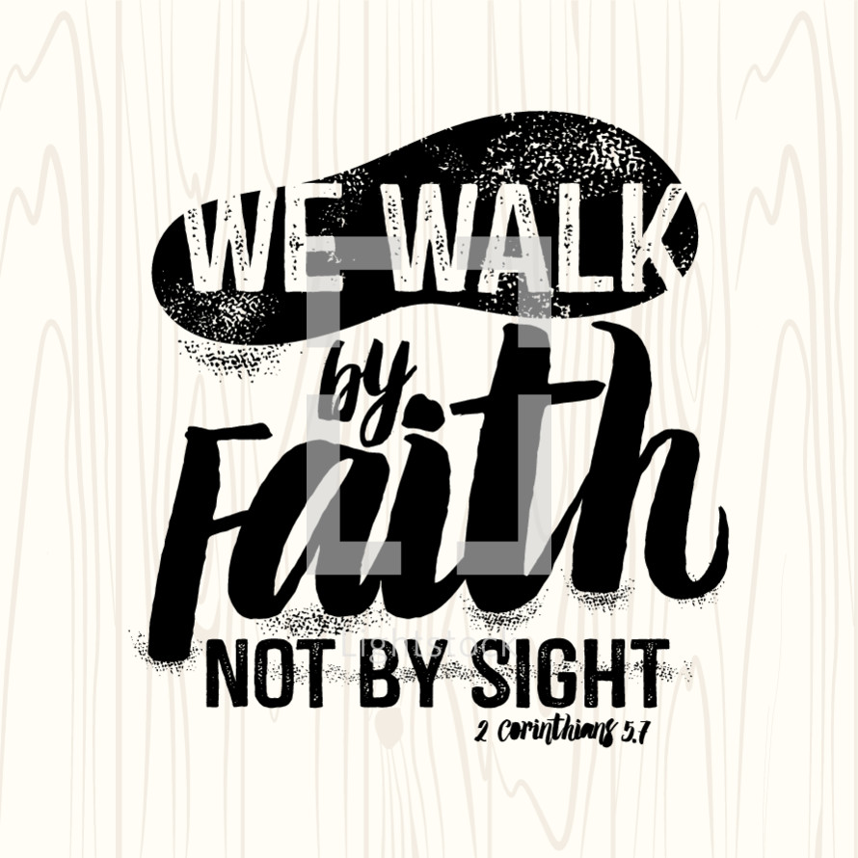
Faith and Sight
Ultimately, to walk by faith is to maintain the same posture as Peter did in John 6:68-69.
It is easy for us to think we are walking by faith when we are really still walking by sight, only going as far as we feel comfortable trusting in Jesus.
Walking by faith is not blind faith: we have every reason for confidence in God based on what He has promised and done for our fathers through the prophets and in Jesus (Heb 1:1-3).

Slide 14

Faith and Sight
Instead, walking by faith is trust: trust in God in Christ not only when it makes complete sense to us to trust in God, but especially when it seems to no longer make any sense.
As the heavens are higher and greater than the earth, so God and His ways are higher than our ways (Isa 55:8-9).
There is so much going on in the creation which we will never understand no matter how far we look or how deep we plumb (Deut 29:29; Job 38:1-41:34).
We become puffed up when we think we know things (1 Cor 8:1);
We do better to repent in dust and ashes like Job and recognize we often think and speak of things well beyond us (Job 42:1-6).

Slide 15
Faith and Sight
God does not expect us to see everything or know everything;
God knows our limitations, for He has made us, and takes pleasure in us as His creation (Psa 8:1-9).
But God does expect us to realize there is far more going on out there than we can understand, and to perceive trusting our senses alone will fail us.
And so, we do well to walk by faith, not by sight trusting in God no matter what the circumstance looks like, and seeking to live like Jesus in thought, word, and deed, to obtain the resurrection of life and to see God face to face for all eternity!

